Slide 1
Java Features
Shristi Technology Labs

Slide 2
Java 9 Features
JShell
Factory Methods for Immutable List,Set,Map
Private Method in interfaces
Process API improvement
Try With Resources improvement
Enhanced @Deprecated Annotation
DiamondOperator for anonymous inner classes
Optional Class Improvements
Reactive Streams
ControlPanel - removed in latest versions

Slide 3
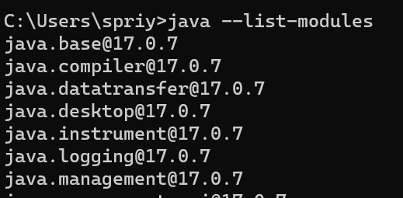
Java Modules
Modules are a new level of abstraction above packages
A module is a group of packages and resources together with a module descriptor file
package of packages(separate project for each module)
The naming rules for a module are similar to packages naming
- reverse DNS names/project-style
By default all packages are module private.
Modules can be distrubuted as JAR or expolded compiled project
can only have one module per JAR file.
Modules are split into four groups - java, javafx, oracle, jdk
java modules are implementation classes for core
java --list-modules
Notes:
Yes exploded means than instead of deploying a WAR/EAR file to your application server to test your application you point your application server at a folder containing the unzipped (exploded) contents of what would be inside the WAR/EAR file.
This makes development quicker as most application servers support Hot Deploy where you can change the code/JSPs etc and these changes will be reflected almost immediately in the running application.
The Tomcat plugin in Eclipse essentially uses this technique. The only thing to be careful of is that after many hot deploys most application servers start to run out of memory in the PermGen space and need restarting (well i've had this problem with Weblogic and Tomcat).

Slide 4
Java Modules
Packages
Packages are used to determine what code is publicly accessible outside of the module.
Resources
Resources like media or configuration files are available in the module
Module Descriptor
Name – the name of the module
Dependencies – a list of modules that this module depends on
Public Packages – a list of packages that can be accessed outside the module
Services Offered – service implementations that can be consumed by other modules
Services Consumed – allows the current module to be a consumer of a service
Reflection Permissions – explicitly allows other classes to use reflection to access the private members of a package

Slide 5
Module Directives
Requires - both runtime and compile time
Requires Static - required only during compile time
Requires Transitive
Exports - export the module for other modules to use
Exports ... To - exports to specific package
uses - consumes the service
Provides ... With - provides the service implementation
Open
Opens
Opens ... To
Notes:
module com.shristi.fourthmodule {
provides com.shristi.demo.Calculator with com.shristi.demo.CalculatorImpl;
// export package name to another package
exports com.shristi.demo to com.shristi.second;
}
module com.shristi.second {
uses com.shristi.demo.Calculator;
requires com.shristi.firstmodule;
requires com.shristi.fourthmodule;
requires static com.shristi.thirdmodule; // available only in compile time
}

Slide 6
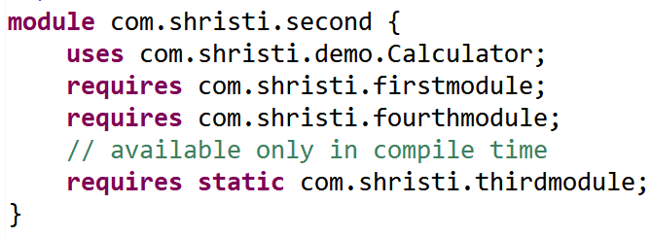
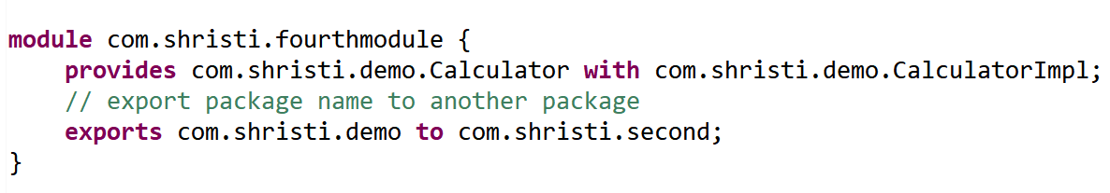
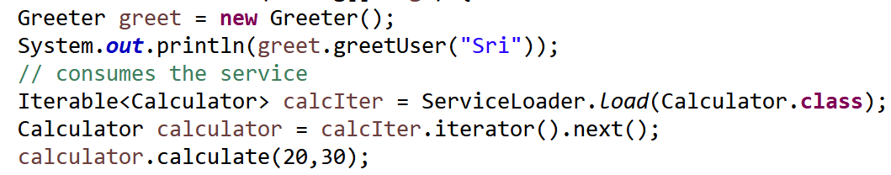
Example

Slide 7
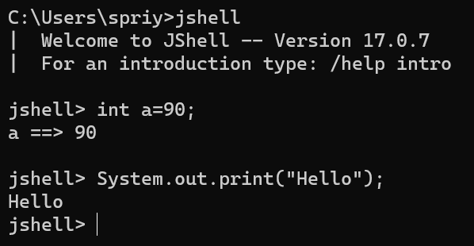
JShell
JShell is Java Shell and known as REPL (Read Evaluate Print Loop).
It is used to execute and test any Java Constructs like class, interface, enum, object, statements etc. very easily.

Slide 8
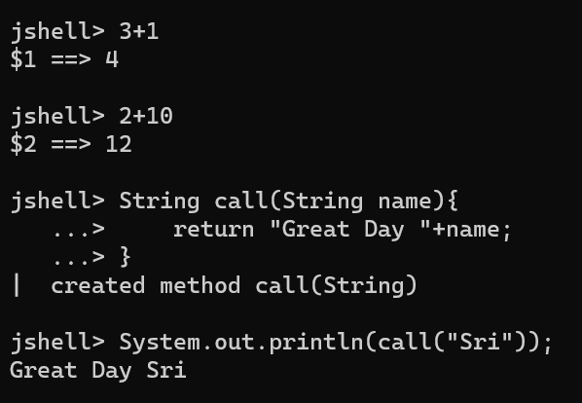
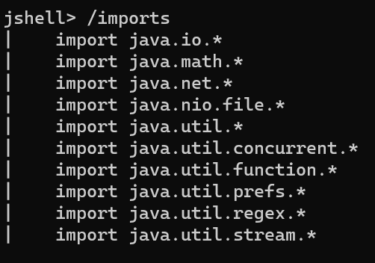
Example

Slide 9
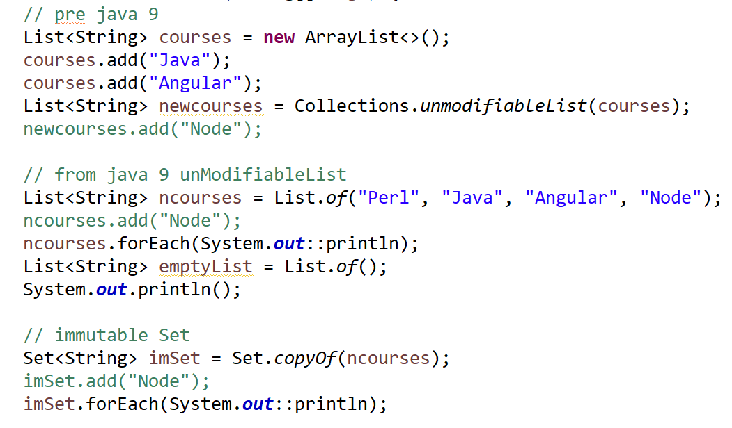
Example - UnmodifiableList, Set

Slide 10
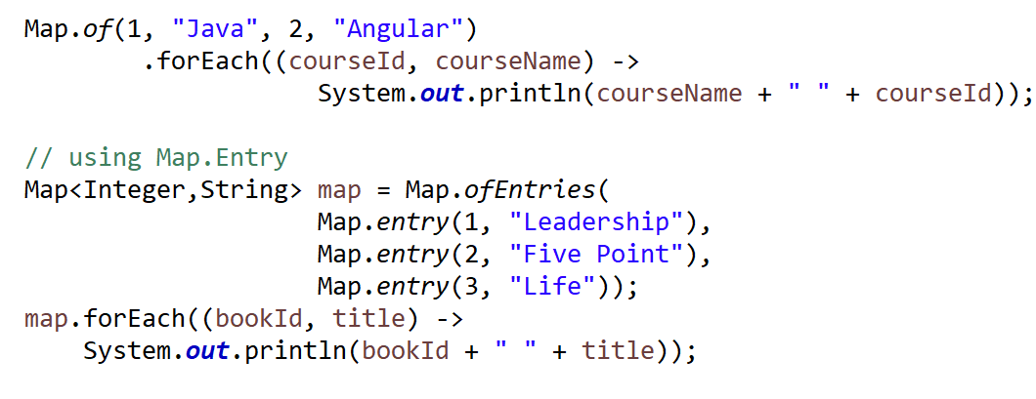
Example - Immutable Map

Slide 11
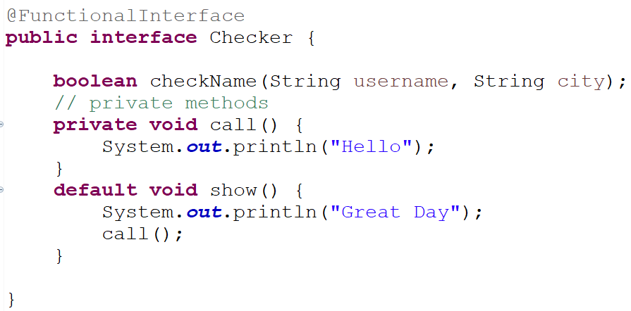
Private methods in an interface

Slide 12
Process API improvement
Process API is responsible to control and manage OS processes
Has new classes and methods to manage the OS processes
ProcessHandle class helps to get
the native process Id,
start time,
accumulated CPU time,arguments,command,
user and parent process
check pocess liveliness and to destroy processes

Slide 13
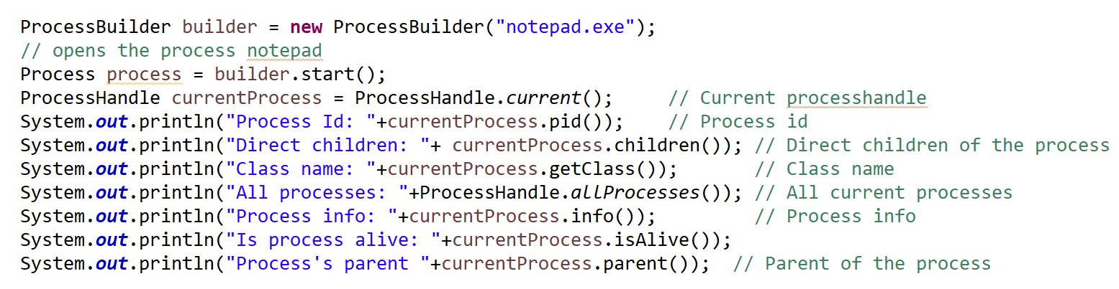
Example for ProcessHandle

Slide 14
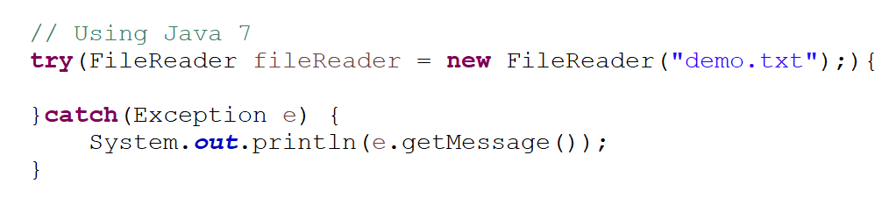
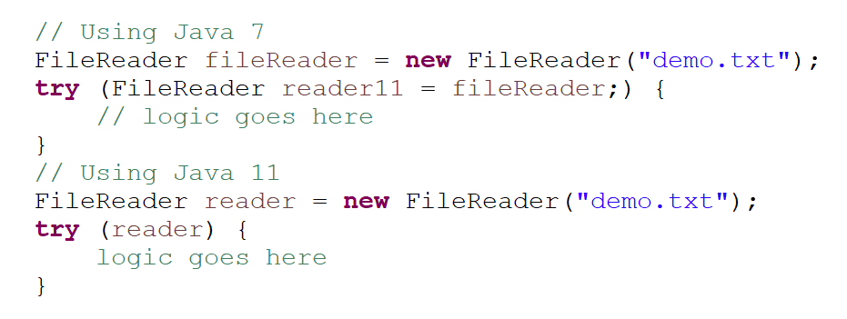
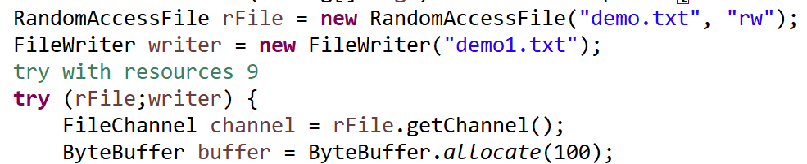
Try With Resources Improvement

Slide 15
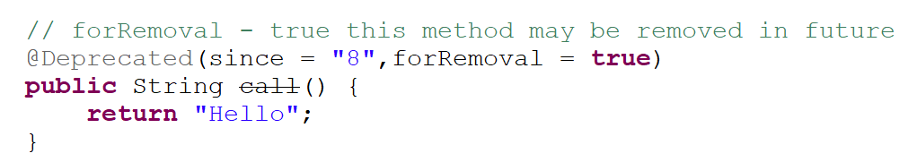
Enhanced @Deprecated annotation
@Deprecated annotation is from java 5
It means it should not be uased as it may lead to errors.

Slide 16
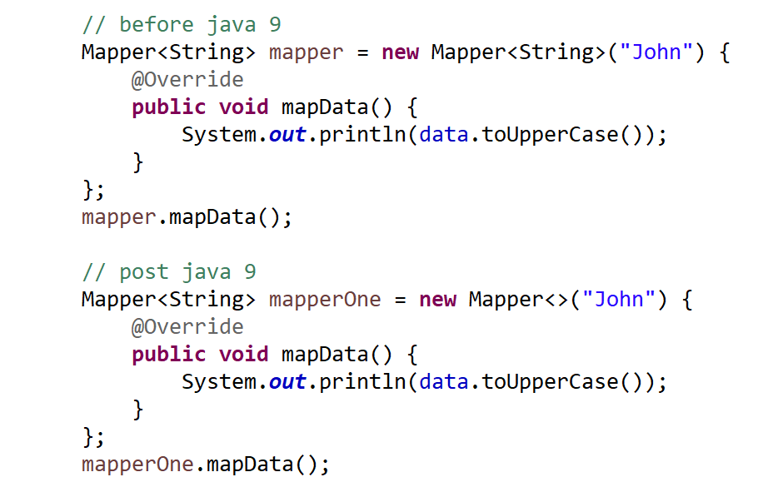
Diamond operator in inner Class
use <> operator with anonymous class after java 9

Slide 17
Reactive Streams
takeWhile() - takes all the values till the predicate returns false
dropWhile() - throws all the values at the start till the predicate returns true.
iterate()
ofNullable()

Slide 18
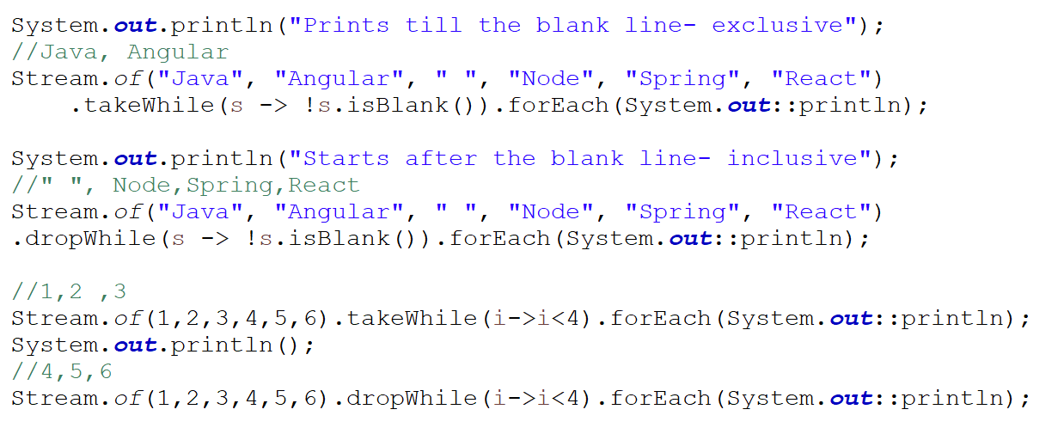
Example of takeWhile and dropWhile

Slide 19
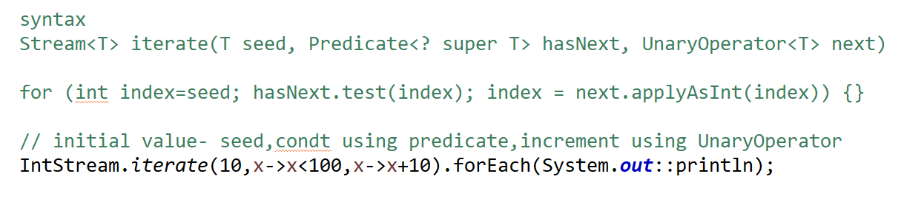
Example of iterate
iterate()
Stream<T> iterate(T seed, Predicate<? super T> hasNext, UnaryOperator<T> next)

Slide 20
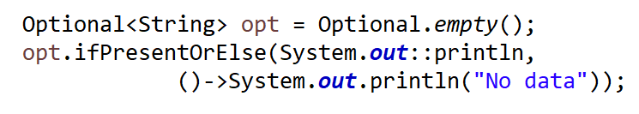
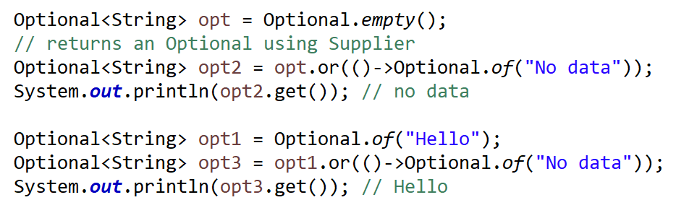
Optional class improvements
New methods of Optional class
stream()
ifPresentOrElse()
or()

Slide 21
Java 10 Features
Local-Variable Type Inference
Consolidate the JDK Forest into a Single Repository
Parallel Full GC for G1
Heap Allocation on Alternative Memory Devices

Slide 22
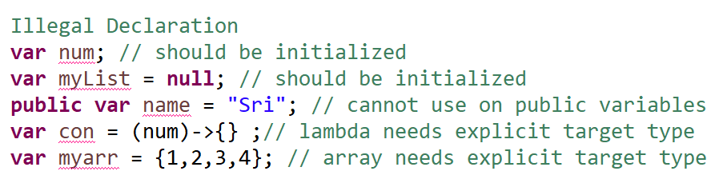
Local-Variable Type Inference
is the new feature in Java 10
Adds type inference to declarations of local variables with initializers.
It can be used in for each / for loop as index
variable with ‘var’ should be initialized
It cannot be initialized to null
It cannot be used with non local variables

Slide 23
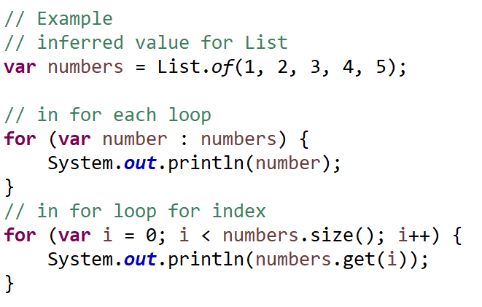
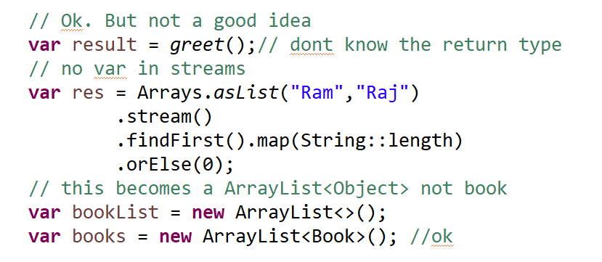
Example - var

Slide 24
Consolidated JDK Forest as Single Repository
In JDK 9, there are eight module based directories termed as repos.
root, corba, hotspot, jaxp, jaxws, jdk, langtools, nashorn
From Java 10 onwards, JDK forests are organized into single repository to streamline development.
Now code in organized as -
$ROOT/src/java.base
$ROOT/src/java.compiler

Slide 25
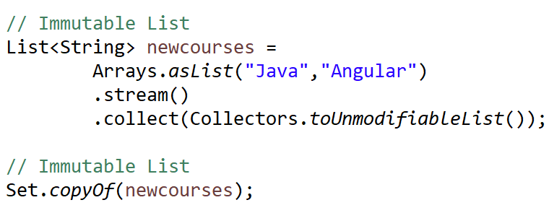
Stream Methods
toUnModifiableList()
copyOf()
OrElseThrow() - to throw NoSuchElementException

Slide 26
Time-Based Release Versioning
Now it is time-based release of Java - a new release every six months.
March 2018 release is JDK 10, September 2018 release is JDK 11 - - These are called feature releases and contains at least one or two significant features
Java 11 is an LTS release
Feature Release
contains language specific features, JVM features, New/Improved APIs, Removal/Deprecation of APIs.
Update Release
includes bug fixes, security issue fix, regression fixes etc.
Each update release happens per quarter in Jan, April, July and Oct months
Long Term Stable Release
Long term support release will be announced after every three years
Notes:
Support for the feature release will last only for six months, i.e., until next feature release
Long-term support release will be marked as LTS. Support for such release will be for three years

Slide 27
Version Format
version format: $FEATURE.$INTERIM.$UPDATE.$PATCH
$FEATURE − It denotes the major feature release and will get incremented by 1 after every Feature Release. like 10,11
$INTERIM − It denotes any non-feature, non-update release which contains bug fixes and enhancements.
$UPDATE − It denotes the Update release done after a feature release. eg,, an update release of Java in Apr 2018 is JDK 10.0.1 and for July 2018 is JDK 10.0.2 and so on.
$PATCH − It denotes any emergency release incremented only in case an critical issue is to be promoted on emergent basis.

Slide 28
Parallel Full GC for G1
Before java 10 - GC (Garbage Collector) implementation components were scattered within code base
In Java 9 - G1 (Garbage First) garbage collector was used.
G1 avoids full garbage collection but in case of concurrent threads look for collection and memory is not revived fast.
With Java 10, now G1 will use a fall back Full Garbage Collection
Moved from single threaded to parallel thread
With JEP 307, a parallel thread will start mark-sweep-compact algorithm.
The number of threads can be controlled using following option.
$java -XX:ParallelGCThreads=4

Slide 29
Heap Allocation on alternative memory
User can specify an alternative memory device, to allocation the java heap space.
User need to pass a path to the file system using a new option -XX:AllocateHeapAt.
-XX:AllocateHeapAt=~/etc/heap
It takes file path and do a memory mapping

Slide 30
Java 11 Features
Running Java File with single command
New utility methods in String class
Local-Variable Syntax for Lambda Parameters
Nested Based Access Control

Slide 31

Running Java File with single command
No need to compile the java source file with javac tool first.
Directly run the file with java command and it implicitly compiles

Slide 32
New utility methods in String class
isBlank() - checks if the string is blank
lines() - returns a stream of strings, is a collection of all substrings split by lines.
strip() - removes all kinds of whitespaces leading and trailing
stripTrailing() - removes all kinds of trailing whitespaces
stripLeading() - removes all kinds of leading whitespaces
repeat(int n) - repeat the string n number of times

Slide 33
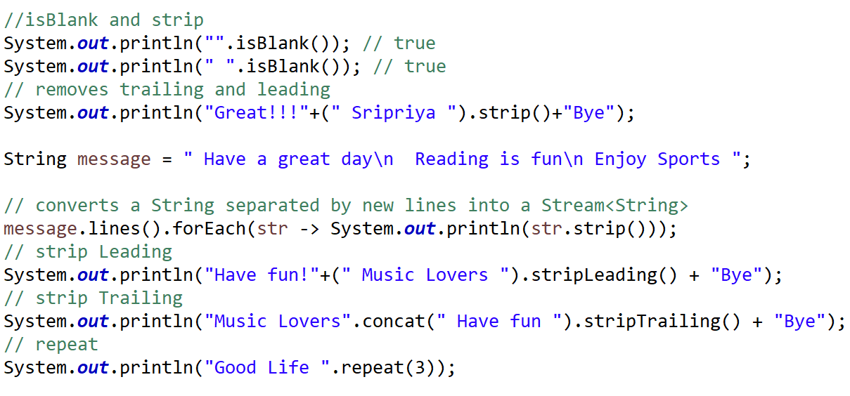
Example

Slide 34
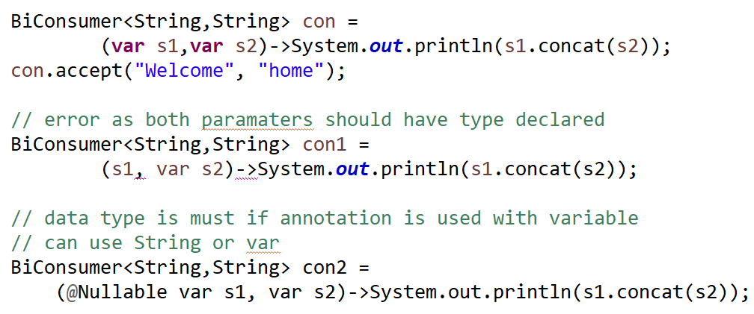
Local-Variable Syntax for Lambda Parameters
This is the only language feature release in Java 11
If an annotation like @Nullable is applied, then type definition is required
Specify for all parameters or none
Even in case of one paramater paranthesis is needed

Slide 35
Nested Based Access Control
Problem:
The nested types have unrestricted access to each other, including to private fields,
Solution
One nest member (typically the top-level class) is designated as the nest host.
It contains an attribute (NestMembers) to identify the other statically known nest members.
Each of the other nest members has an attribute (NestHost) to identify its nest host.

Slide 36
Performance Tuning
Use a profiler to find the real bottleneck
Avoid BigDecimal or BigInteger
Use StringBuilder to concatenate Strings programmatically
Use + to concatenate Strings in in one statement(in case of a query)
Use primitives whereever possible
Cache expensive resources, like database connections and creating Integer objects

Slide 37
Performance Tuning
Use the Latest Stable Java Version
Size the Java Heap memory correctly - using Xmx, Xms
Donot have the heapsize too small
Set the initial heap size java -Xms256m -Xmx2048m
Xms is the initial setting of the heap memory size
Use StoredProcedures instead of queries as SP are precompiled
Choose the right garbage collector (SerialGC, Parallel GC)
Tune the JVM Garbage Collector to reduce the time required for a full GC
Avoid Database connection delays. Use Pools

Slide 38
JNI - Java Native Interface
JNI is an interface that allows Java to interact with code written in another language.
Supports code reusability and performance.
Can reuse existing/legacy code with Java (mostly C/C++).
The native code used to be up to 20 times faster than Java, when running in interpreted mode.
JNI can be used to invoke Java code from within natively-written applications written in C/C++.
Java command-line utility is an example, that launches Java code in a Java Virtual Machine.

Slide 39
JNI Components
Java Code – The class with native method.
Native Code – the actual logic of native methods, coded in C or C++.
JNI header file – this header file for C/C++ (include/jni.h into the JDK directory) includes all definitions of JNI elements that we may use into our native programs.
C/C++ Compiler – Choose between GCC, Clang, Visual Studio, or to generate a native shared library for our platform.

Slide 40
JNI Data Mapping to variables
boolean | jboolean
byte | jbyte
char | jchar
double | jdouble
float | jfloat
int | jint
long | jlong
short | jshort
void | void

Slide 41
Java 16
Records

Slide 42
Records
Record Class is the common base class of all record classes
It is a transparent carrier for a fixed set of values
The variables are called the record components - they are final
Records can have static fields, static block
Records have fields, all-args constructor, getters, toString, and equals/hashCode methods
Records are immutable. No setter methods
Record classes are final. Records can implement other interfaces
Records are used as data transfer objects (DTOs)

Slide 43
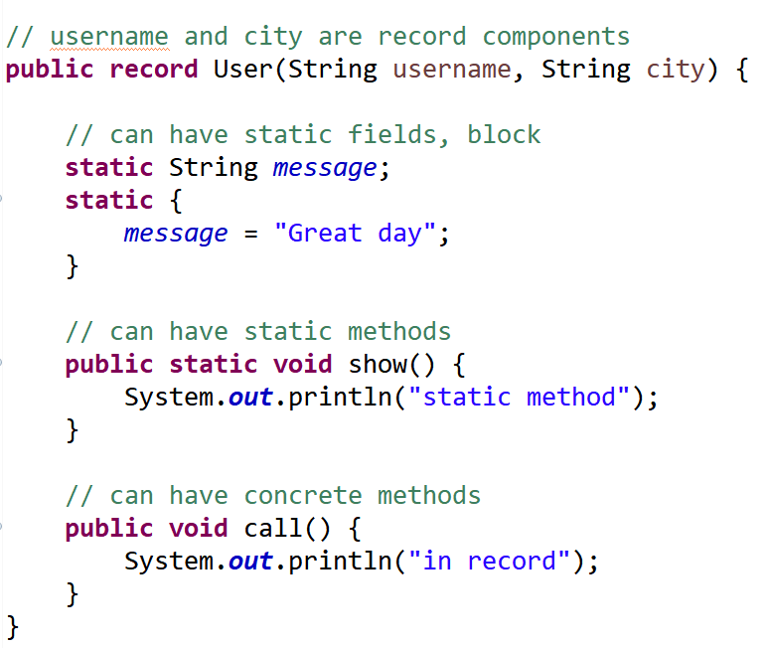
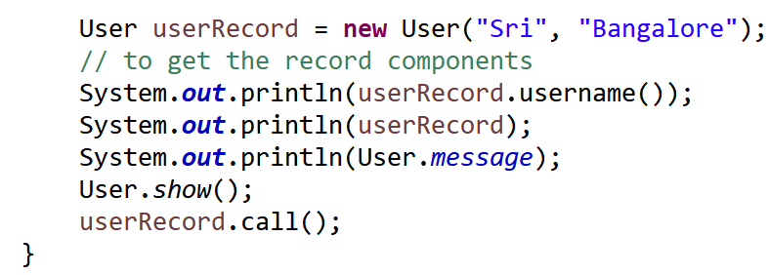
Example

Slide 44
Java 17
Sealed Classes

Slide 45

Sealed Classes
A sealed class allows to choose its sub-classes.
Use the keyword sealed to create a sealed class.
A sealed class must be followed by permits keyword along with the list of classes that can extend it.
The permits clause specifies the classes that are permitted to extend the sealed class/implement the sealed interface
The extending classes should be sealed/non-sealed/final
eg.,

Slide 46
Non-Sealed Classes
If a class is non-sealed the parent-child hierarchy ends here.
But the non-sealed class can be extended by other classes
Use the keyword non-sealed to create a non-sealed class.
This class cannot be extended

Slide 47
Rules
A sealed class must define the classes that may extend it using permits
The permitted child class must extend the sealed class and must either be final, sealed or non-sealed.
If the parent sealed class is in a module, then the child classes must also be in the same module
If the parent sealed class is in an unnamed module, then the child classes must in the same package,
The non-sealed class can be extended

Slide 48
Sealed Interface
An interface may allow to choose its child interfaces or classes that can extend it using permits.

Slide 49

Sealed Records
A record can not extend a normal class,but can implement a sealed interface.
Further, a record is implicitly final.

Slide 50
Thank you

